Slide 1
Pandemic Open Portal
Covid-19 Global Hackathon
Oscar DeLeon
March 29,2020

Slide 2

mission statement
Centralize the coordination and cooperation among citizens, private organizations, and government personnel in a manner that drastically reduces the response times of both local and cross-regional pandemic support efforts.

Slide 3
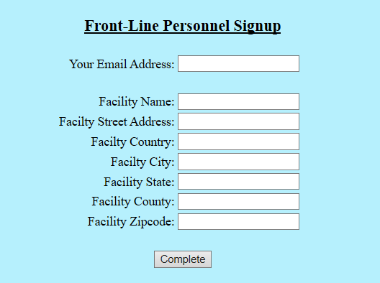
Frontline support submissions

Slide 4
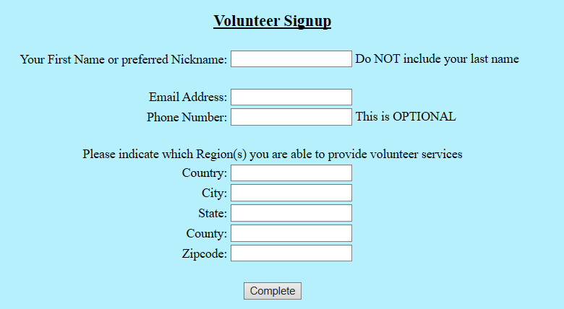
Volunteer signup

Slide 5
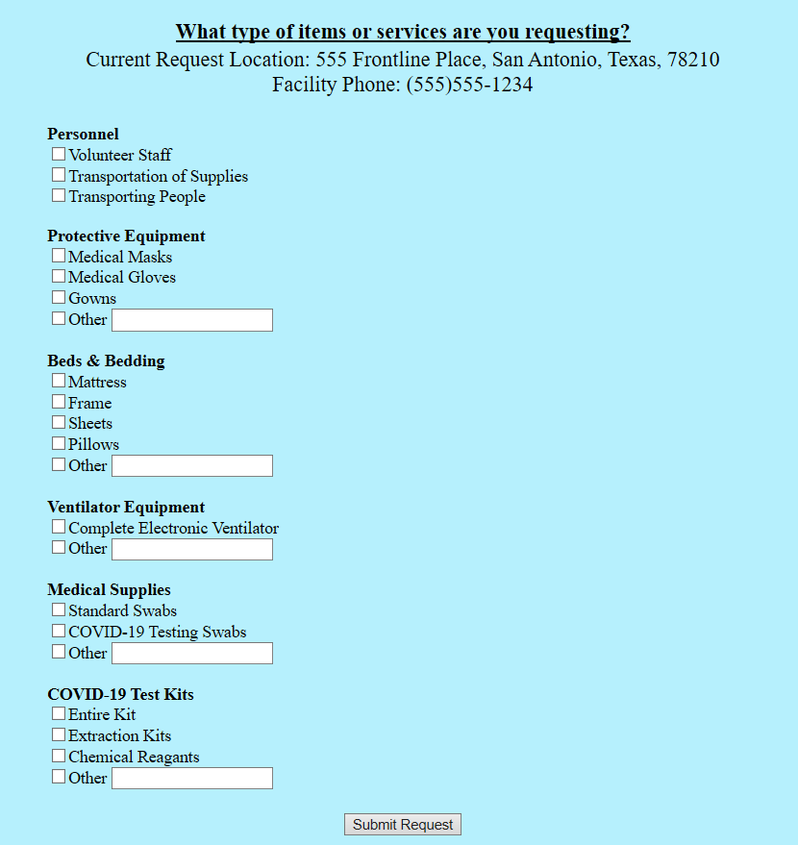
Frontline support needs

Slide 6
System notifications
Congratulations!
You have been assigned a work request.
Please review the details here: https://#AppHome/requestDetailsPage
Thanks for being a volunteer!

Slide 7
System notifications
Hello! Our system shows that a Volunteer is currently assigned to one or more of your requests.
Please review the following work item and select a quick status update: http://#AppHome/requestDetailsPage

Slide 8
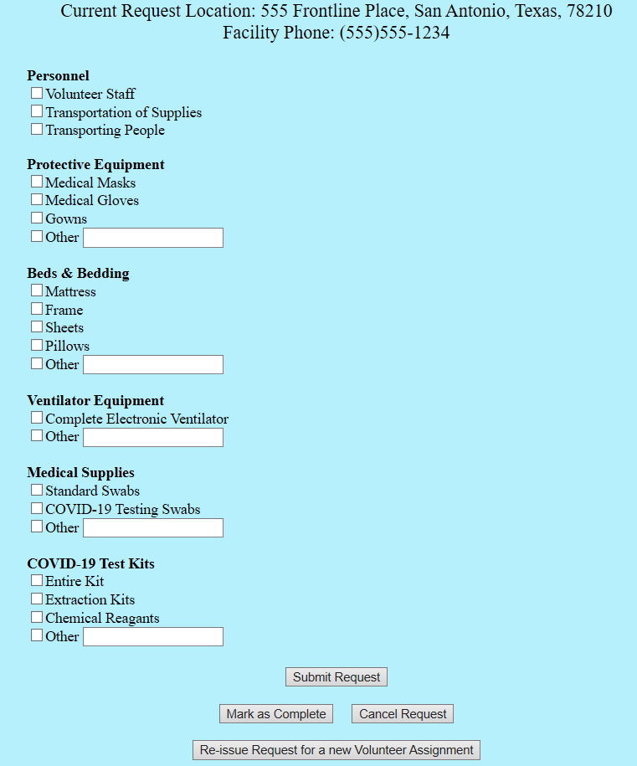
Work finalization

Slide 9
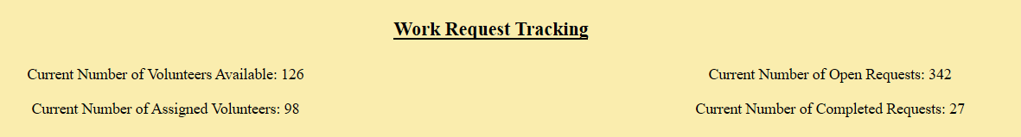
Work request tracking

Slide 10
Online prototype
Visit
http://pop.techbuiltempire.com

